Slide 1

Bank Customer Data Analysis and Visualization

Slide 2

Team Members Details:
Pranav Singh(RA2211003010540)
Manish Tiwari(RA2211003010546)
Swastik Rana(RA2211003010564)

Slide 3

Introduction to the Dataset
The Bank Customers dataset contains information on customers of a bank, including their balance, loan status, and details. This data can be used to gain insights into customer behavior and preferences, as well as inform marketing and product development strategies.
The dataset is provided in the Problem Statement2_Dataset folder and can be accessed using Python libraries such as Pandas and NumPy.

Slide 4
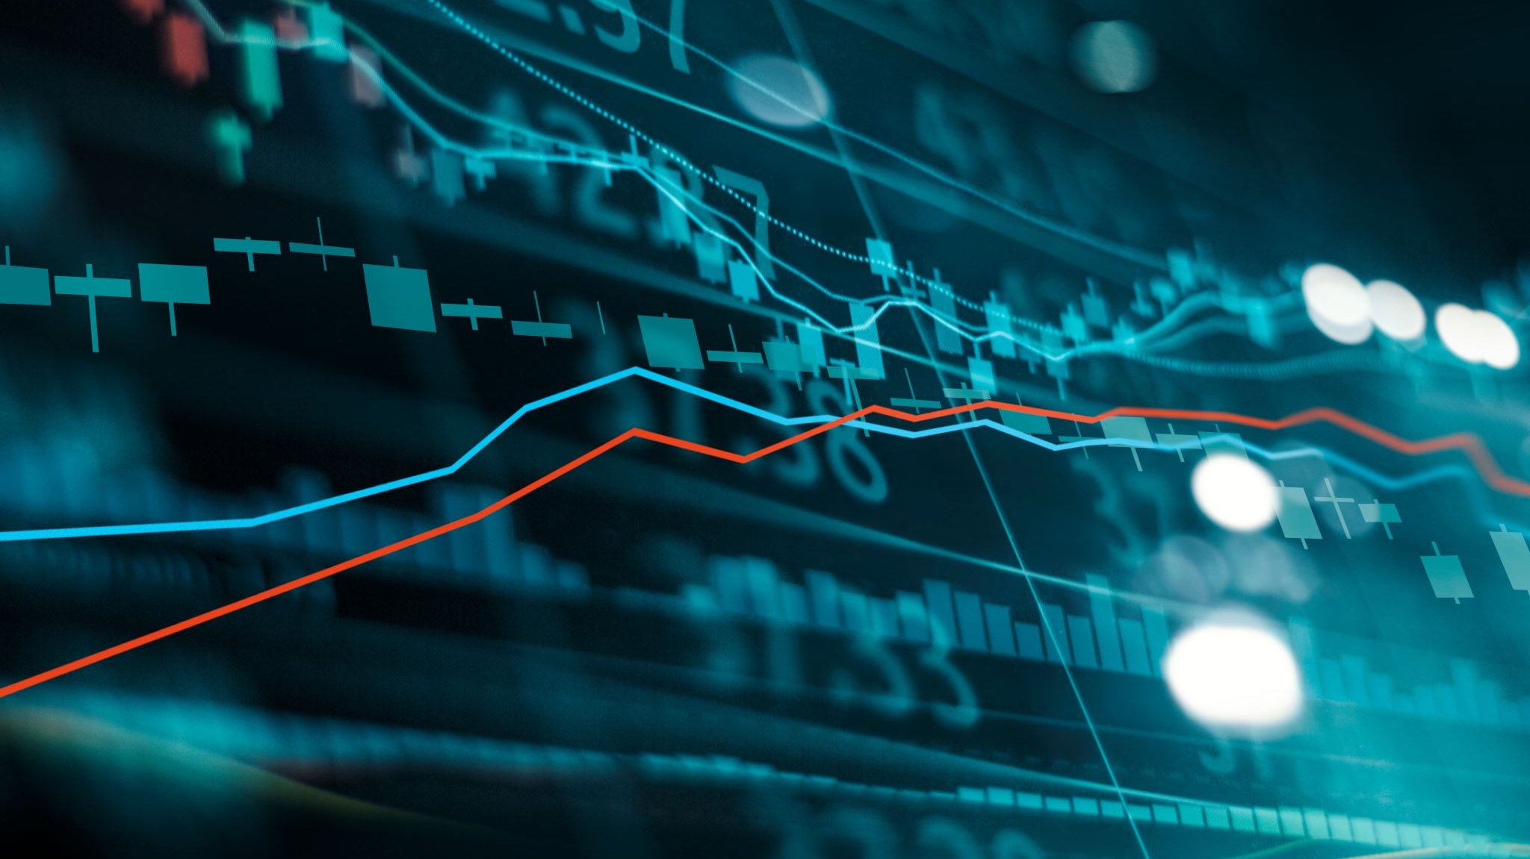
Exploratory Data Analysis:
The Bank Customers dataset contains information about customers of a bank. The primary objective of exploratory data analysis is to gain insights into the data and identify any patterns or relationships that may exist.
Some of the key variables in the dataset include age, gender, education level, income, and other details. By analyzing these variables, we can gain a better understanding of the characteristics of the bank's customers and their financial behavior.

Slide 5
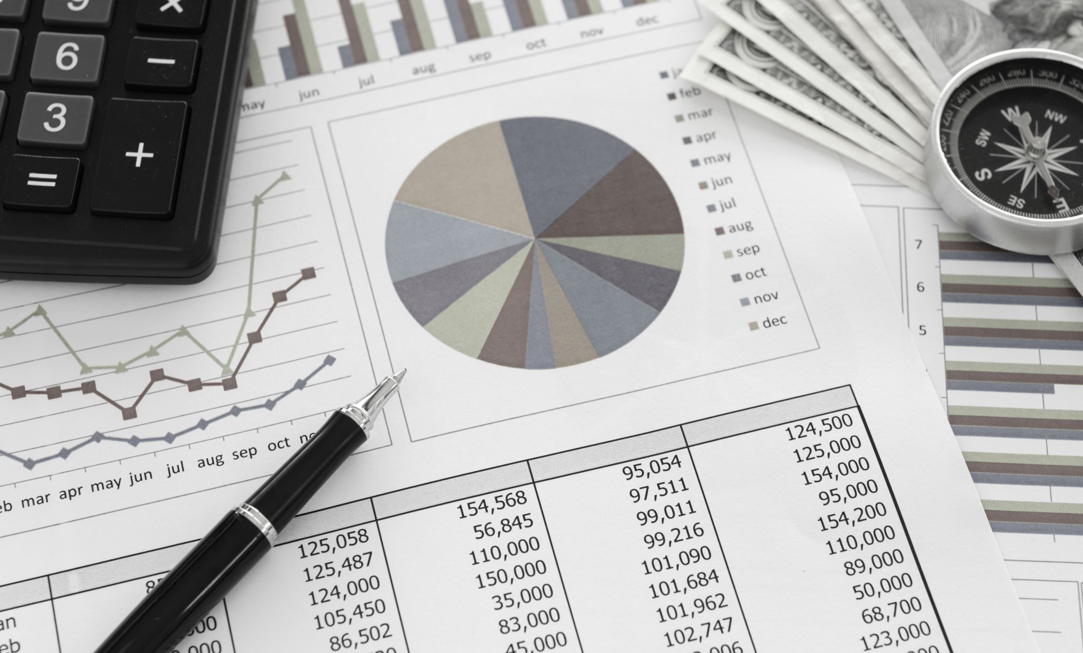
Data Visualization:
Distribution of Age :
A histogram can be used to visualize the distribution of age among bank customers.
Correlation :
A correlation heatmap can be used to visualize the correlation between different variables in the dataset, such as age, balance, and duration.

Slide 6
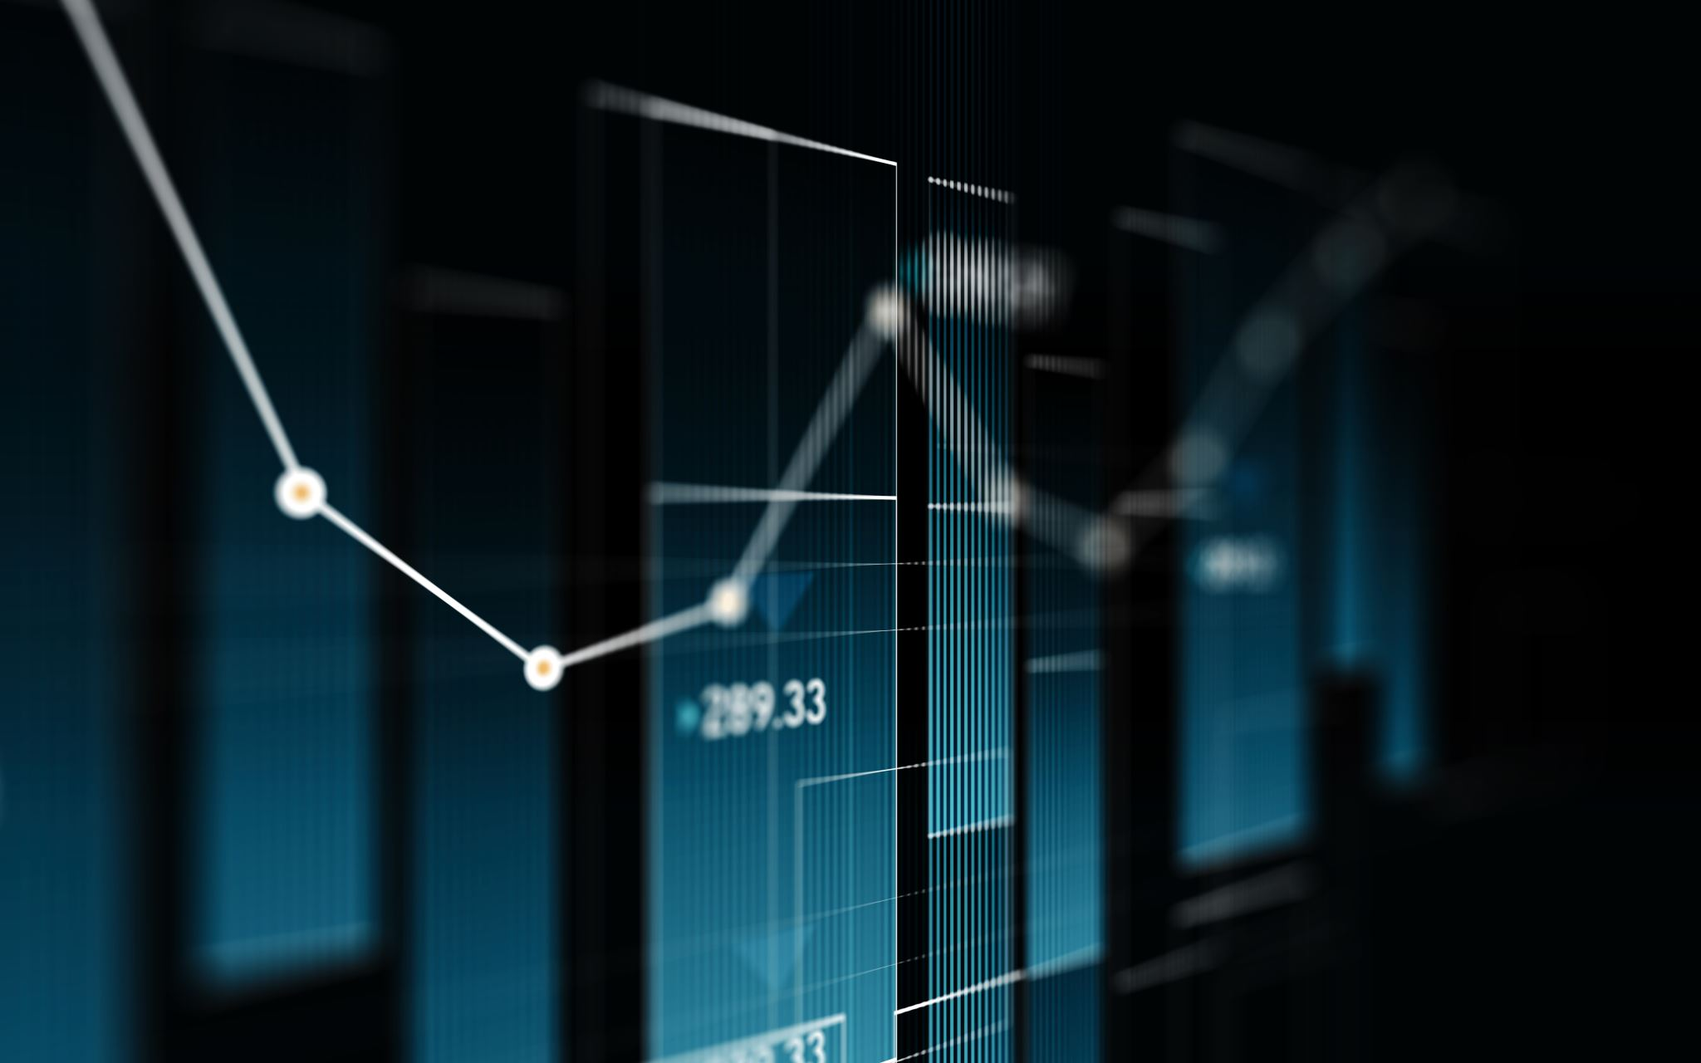
Comparing Data Visualization Libraries in Python:
Matplotlib: A foundational library known for customizability and widespread use. Example visuals.
Seaborn: Enhances Matplotlib with themes and built-in styles. Sample Seaborn plots.
Pandas Plotting: Quick and simple plots within Pandas. Basic plotting examples.
SciPy: It is a Python library for scientific and technical computing, providing tools for optimization, integration, interpolation, and more.

Slide 7
Learning outcomes:
We have learned various new topics and new python libraries like matpotlib , seaborn , pandas , scipy .
We also have learned how to make histography and bar chart using matpotlib , seaborn.
We also learned how to make a scatter graph during the given time duration.
We also learned how to make correlation graph and scipy python library for statistic and computation method .

Slide 8

conclusion
In conclusion, the analysis and visualization of bank customer data using Python have allowed us to gain valuable insights into the bank's operations and customer behavior. Through a variety of charts, graphs, and statistical analyses, we've identified key trends, customer preferences, and potential areas for improvement. This data-driven approach can aid in making informed business decisions, enhancing customer experiences, and ultimately, contributing to the bank's success in a competitive financial landscape. The power of Python's data analysis and visualization tools has enabled us to turn raw data into actionable knowledge for the betterment of the bank and its customers.

